Slide 1
CSM 61A Inter Mt1-2 Review
Saturday, March 2, 2019

Slide 2
Welcome!
CSM 61A InterMT Review
Fill out: yellkey.com/little (anon, 30-sec survey)

Slide 3
Lists

Slide 4
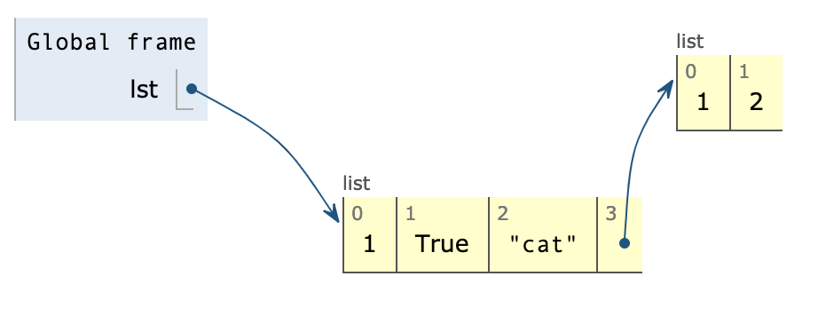

Lists Summary
Box and Pointer visual representation
Can hold arbitrary types
Index into a list by using brackets [], for example lst[1]
>>> lst = [1, True, ‘picture of Prof. Garcia’, [1, 2]]
>>> lst2 = lst
>>> lst2[1]
True

Slide 5
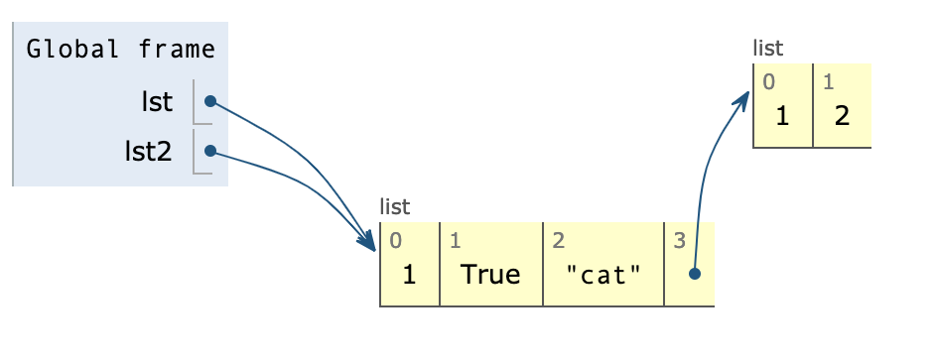
Lists Summary
Box and Pointer visual representation
Can hold arbitrary types
Index into a list by using brackets [], for example lst[1]
>>> lst = [1, True, ‘picture of Prof. Garcia’, [1, 2]]
>>> lst2 = lst
>>> lst2[1]
True
Computers are Lazy!

Slide 6
List Methods: Mutative vs. Non-mutative
Mutative (Edits Original List) | Non-mutative (Creates New List)
.append(single element/list) .extend([list of elements]) .insert(index, element) lst += lst2 (equivalent to extend) .pop(index) <- (index is optional) Returns element of that index | lst = lst1 + lst2 (NOT equivalent to +=) list(lst) lst[:] (any slicing) lst = [lst2] WARNING: Even though we are creating a new list, if there is a list nested inside of another list, it creates a POINTER to that list instead of copying the entire list
Return
None!
>>> a = lst.append(2)
>>> print(a)
None

Slide 7
List Comprehension Summary
new_list = [] for i in old_list: if filter(i): new_list.append(expressions(i))
GENERAL FORM:
[ expression for item in list if conditional]
(optional)
new_list = [expression(i) for i in old_list if filter(i)]

Slide 8
List Comprehension Example
def divisors(n):
return [1] + [x for x in range(2, n) if n % x == 0]
>>> divisors(24)
[1, 2, 3, 4, 6, 8, 12]
>>> divisors(17)
[1]

Slide 9
Lists #1 (Egg - Midterm 2): Environment Diagram!
def scramble(egg):
return [egg, over(egg)]
def over(easy):
easy[1] = [[easy], 2]
return list(easy[1])
egg = scramble([12, 24])

Slide 10
Lists #1 (Egg - Midterm 2): Solutions
Live presentation!
Or Python Tutor: https://goo.gl/bQNuiY

Slide 11
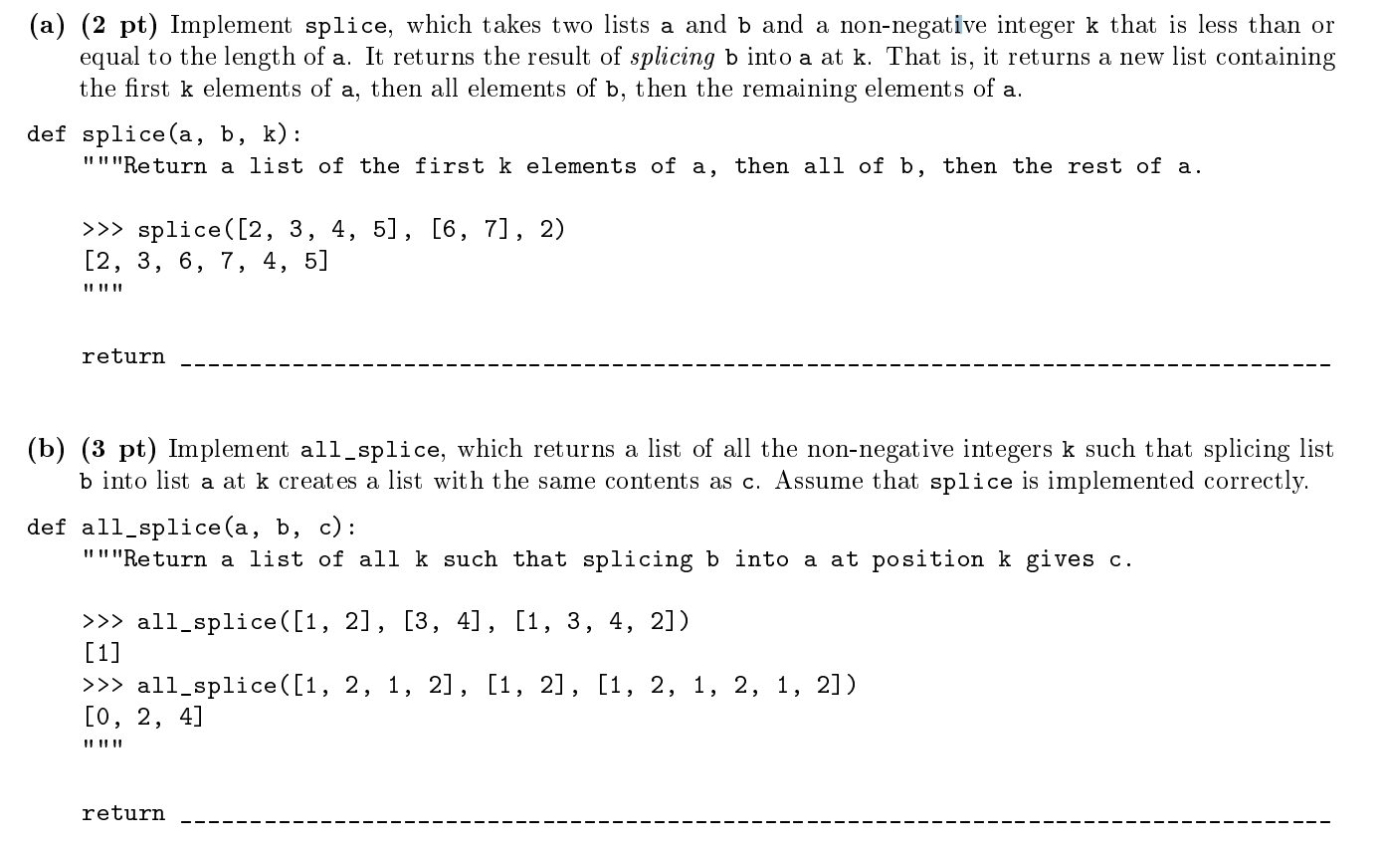
List #2 (Pumpkin Splice Latte - Midterm 2)

Slide 12
List #2 (Pumpkin Splice Latte - Midterm 2) Solutions
a[:k] + b + a[k:]
[k for k in range(len(a) + 1) if splice(a, b, k) == c]
Notes:
K is not the same as index! Therefore need to go to len(a) + 1, the number put into range is exclusive

Slide 13
Recursion
Notes:
Should be 10:35 when we reach this point.

Slide 14
Recursion Summary:
2 parts to any recursion problem -
Recursive case - given a problem, how do we break it up into similar smaller problems?
Base case - at what point do we no longer have to break up the problem? What’s the most trivial case?
How do you combine recursive cases?
Notes:
10:38

Slide 15
Recursion Tips:
Ignore code and Identify Recurrence
Identify Simple Cases → Base Case
Identify Combining Function
Pretend the function ALREADY WORKS
Beginning: Write out the recursive tree
Notes:
Ask students for more tips

Slide 16
Recursion #1
Create a function that converts a positive integer to base 2
Remember: 5 in base 2 -> 101 since 5 = (1 * 2⁰)+ (0 * 2¹) + (1 * 2²)
Notes:
10:40

Slide 17
Recursion #1: Solutions
Create a function that converts a positive integer to base 2
def to_base_2(n):
if n == 1:
return 1
if n == 0:
return 0
return 10 * to_base_2(n//2) + to_base_2(n%2)
Notes:
Cover until 10:45

Slide 18
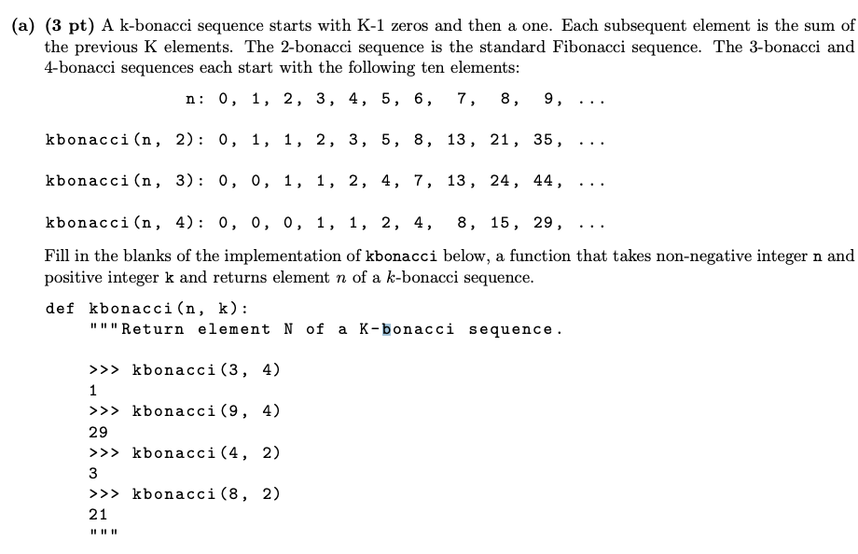
Recursion #2
You would have 5-7 mins to work on such a problem during the exam
Notes:
10:45-10:50

Slide 19
Recursion #2
def kbonacci(n, k):
if n < k - 1:
return 0
elif n == k - 1:
return 1
else:
total = 0
i = ____________________
while i < n:
total = total + ____________________
i = i + 1
return total

Slide 20
Recursion #2: Solutions
def kbonacci(n, k):
if n < k - 1:
return 0
elif n == k - 1:
return 1
else:
total = 0
i = n - k
while i < n:
total = total + kbonacci(i, k)
i = i + 1
return total

Slide 21
Tree Recursion
Notes:
Should be 11:00 when we reach this point.

Slide 22
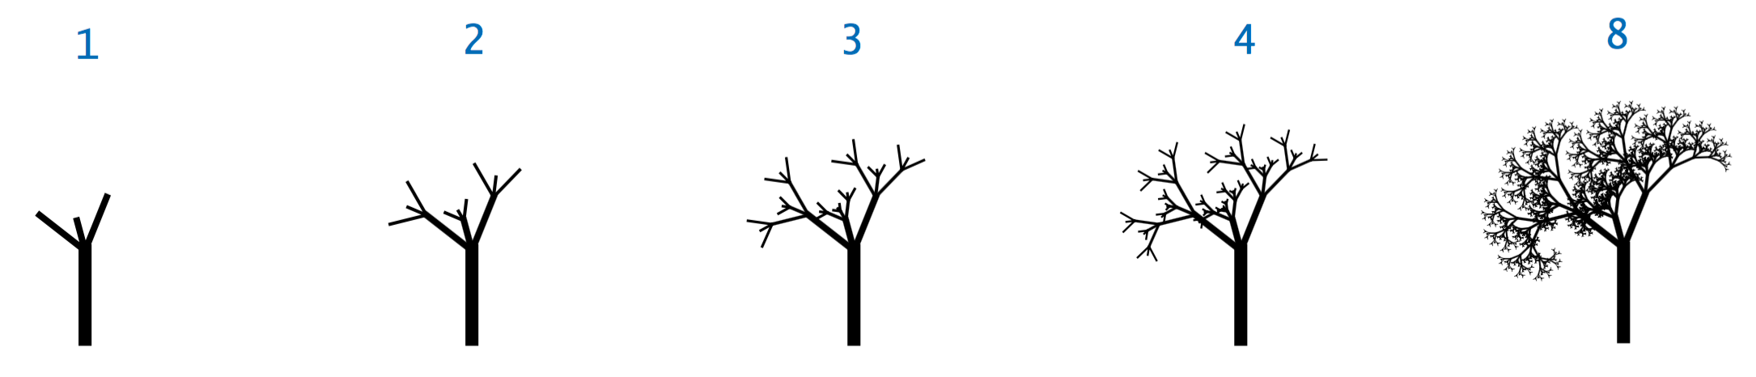
Visually

Slide 23
Tree Recursion Summary
>1 recursive calls
Tips:
Identify Cases
Draw out a tree with diff cases
Determine how arguments change
Identify combine function
Notes:
11:03

Slide 24
Tree Recursion #1: Min Element
> tree_rec_min([1, 3, 4, 2]):
1
> tree_rec_min([4, 5, 2, -7, 100]):
-7
Notes:
11:05

Slide 25
Tree Recursion #1: Min Element
#assume len(lst) > 0
def tree_rec_min(lst):
if ___________:
return ____________
_______ = ______________
return smaller(_____________, ____________)
def smaller(a, b):
return a if a < b else b
Notes:
11:06

Slide 26
Tree Recursion #1 Min Element: Solution
def tree_rec_min(lst):
if len(lst) == 1:
return lst[0]
median_index = len(lst) // 2
return smaller(tree_rec_min(lst[:median_index]),\ tree_rec_min(lst[median_index:]))
def smaller(a, b):
return a if a < b else b
Notes:
11:08

Slide 27
Tree Recursion #2: Make_Change
Min # coins needed to make n cents if we had [1, 3, 4] cent coins
> make_change(6):
2 # Use two 3-cent coins
> make_change(10):
3 # Use 4 + 3 + 3
Notes:
11:15

Slide 28
Tree Recursion #2: Make_Change
def make_change(n):
if n == 0:
return __________
elif n < 0:
return __________
else:
______ = ______________
______ = ______________
______ = ______________
return ____________________
Notes:
11:16-11:20. Make a mistake in the 1 + min() on purpose. Have them catch.

Slide 29
Tree Recursion #2 Make_Change: Solution
def make_change(n):
if n == 0:
return 0
elif n < 0:
return float(“inf”) # -infinity, handle (-) inputs
else:
use_1 = make_change(n-1)
use_3 = make_change(n-3)
use_4 = make_change(n-4)
return 1 + min(use_1, use_3, use_4)
Notes:
11:20-11:28

Slide 30
Tree Recursion #2 Make_Change: Another Solution
def make_change(n):
if n == 0:
return 0
elif n < 0:
return float(“inf”)
else:
use_1 = make_change(n-1)
use_3 = make_change(n-3)
use_4 = make_change(n-4)
return 1 + min(use_1, use_3, use_4)
def make_change(n):
if n < 1:
return 0
elif n < 3:
return 1 + make_change(n - 1)
elif n < 4:
use_1 = 1 + make_change(n - 1)
use_3 = 1 + make_change(n - 3)
return min(use_1, use_3)
else:
use_1 = 1 + make_change(n - 1)
use_3 = 1 + make_change(n - 3)
use_4 = 1 + make_change(n - 4)
return min(use_1, use_3, use_4)
Notes:
11:28-11:29. Ask for other cool solutions.

Slide 31
Make_change Extension
1. How would we modify the function to allow any list of coins?
Ex: coins = [1, 3, 5, 6, 7]
def make_change(n, coins):
2. Chicken McNugget Problem: What is the largest number we cannot make change with if we have two coins m, n?
Notes:
11:29

Slide 32
Trees and Recursion on Trees
Notes:
Should be 11:30 when we reach this point.

Slide 33
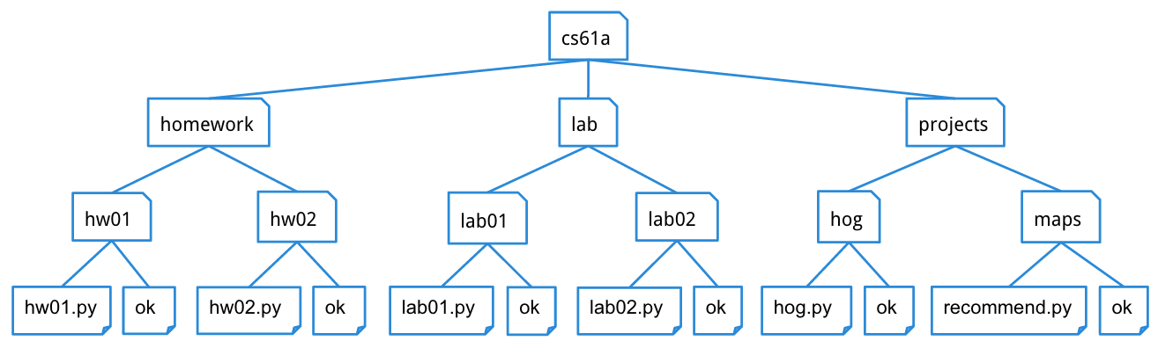
Trees Summary
Type of Mutable Data Structure
Useful for showing a hierarchy or dependency relationship, but not limited to that
There are nodes and each node has a 0 or more branches
0 branches - reached a leaf, end of a branch
1 tree - Many subtrees
Many ways to iterate over the elements of a tree

Slide 34
Tree Recursion vs. Recursion on Trees
Tree Recursion
It’s a version of normal recursion
Doesn’t use a tree data structure and is not related to it
Used to solve all sort of problems not just trees
Sometimes it is useful to draw it out using a tree structure
Multiple recursive calls to function
Recursion on Trees
Using recursion on trees to iterate across the elements of the data structure
Used specifically on tree data structures
Usually involves a recursive call to the branches of the node if they exist

Slide 35
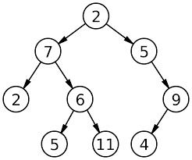
Trees #1
Implement a function height, which returns the height of a Tree.
def height(t): """Returns the height of the tree. >>> leaf = Tree(1) >>> height(leaf) 0 >>> t1 = Tree(1, [Tree(2, [Tree(4)]), Tree(3)]) >>> height(t1) 2 """ if ___________________________________: ___________________________________ _____________________________________
0
1
Height = 3
2
3

Slide 36
Trees #1: Solutions
def height(t): if len(branches(t)) == 0: return 0 return 1 + max([height(child) for branch in branches(t)])

Slide 37
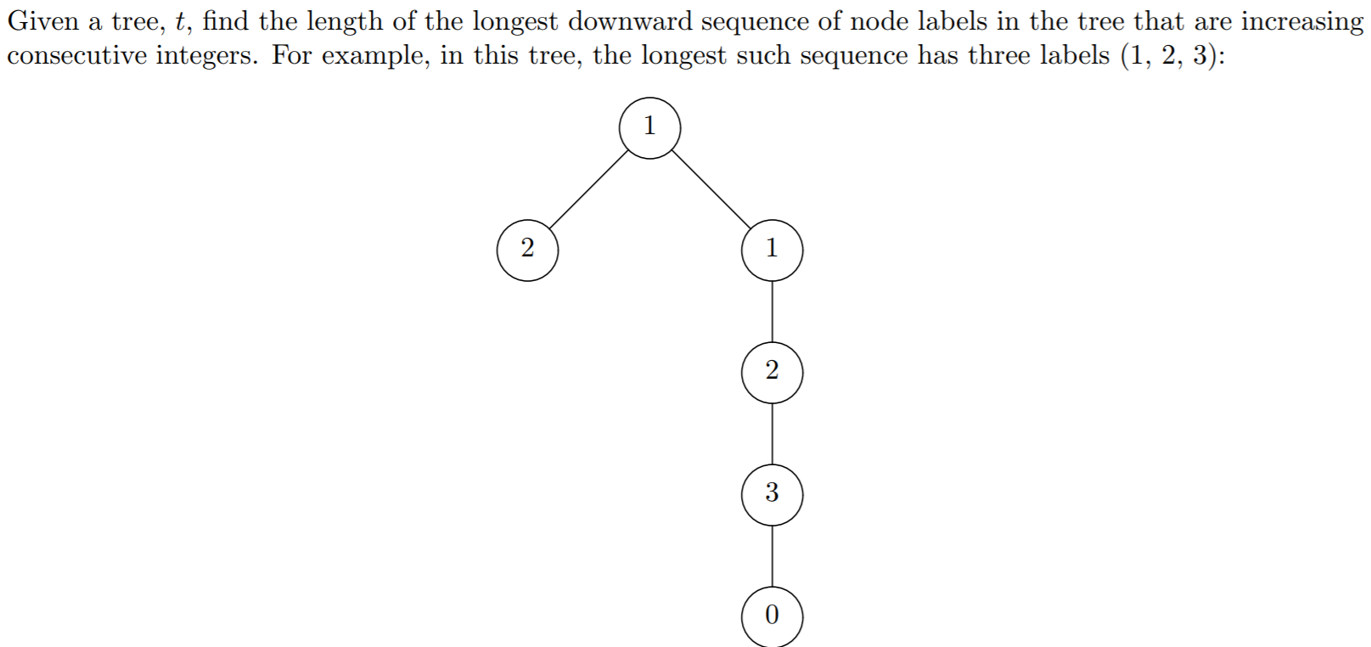
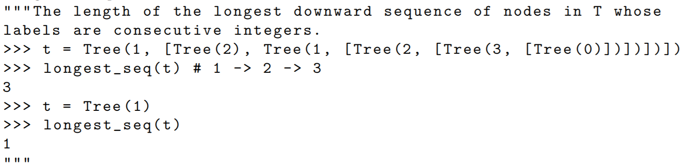
Trees #2
def longest_seq( t ): max_len = 1 def longest( t ): _______________________________ n = 1 if _______________________________: for _________________________ __________________________ if________________________ n = _________________________________ max_len = _______________________________________ return n longest(tr) return max_len

Slide 38
Trees #2: Solutions
def longest_seq( t ): max_len = 1 def longest( t ): nonlocal max_len n = 1 if not is_leaf(t): for b in branches(t): L = longest(b) if label(b) == label(t) + 1: n = max (n , L + 1) max_len = max (n , max_len) return n longest( tr ) return max_len

Slide 39
Resources
Guerilla section right now: 12-2PM, Soda 271
Practice
Python Tutor
CS 370 1-1 Tutoring
CSM Drop In Sections
Resources webpage on 61A site
HKN Drop-in Tutoring

Slide 40
Thank you
Any questions?

